Slide 1
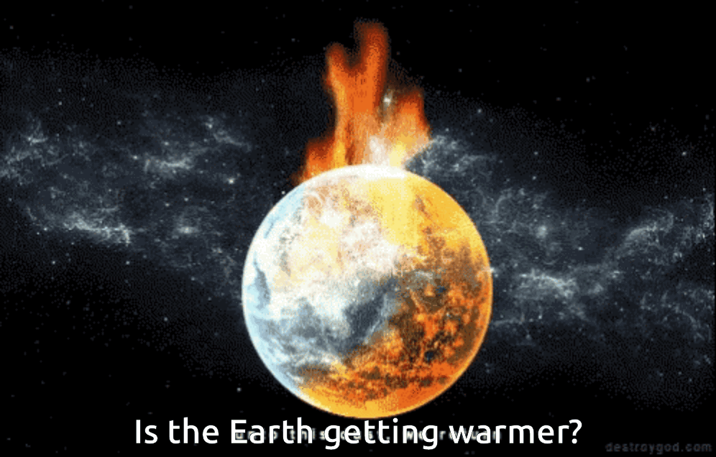




SIRIUS
POWERPOINT TEMPLATE
facebook.com
twitter.com
mail@mail.com
+81 12 3456 7890

Slide 2
THERMAL WARMING?
Who updates this : Albert
A STUDY OF GLOBAL TEMPERATURE, CO2 AND RADIATION
Describe the core message or hypothesis for your project.
Describe the questions you and your group found interesting, and what motivated you to answer them
Summarize where and how you found the data you used to answer these questions

Slide 3
ASSUMPTIOPNS
UOM
RADIATION
GHG
All values are at global levels measured in metrics(???). Currently we are getting data as
SOLAR RADIATION
Greenhouse Gases (GHG)
Temp in Centigrade
Solar Radiation in Watts/m2
CO2 and Air quality in metric tonnes / m2
Solar Radiation Comes as Total Solar Irradiance for NRL2 NASA project which takes care of uncertainties / measurement variations
Out of Greenhouse Gases (GHG), maximum contribution towards temp rise comes from CO2. So other GHG are ignored

Slide 4
HELLO,
LET ME INTRODUCE OUR GROUP…
Albert Gendelman
Guy Thompson
Madhuram Swaminathan
Steve
Wang
More information here if desired.

Slide 5





Steve – On Temp Extraction
Guy – On Temp Cleaning
Madhu – points on other Datasets
Describe the data exploration and cleanup process (accompanied by your Jupyter Notebook)
Handle Missing values and clean the data
Merging Data
Find Relationship between
Temp vs CO2
Temp vs Solar Radiation
CO2 vs Solar Radiation
Plot
Time-series representation of Temp rise
Impact of Solar Radiation on Temp
Impact of Co2 on Temp
Impact of both on Temp

Slide 6
Madhu
Describe the analysis process (accompanied by your Jupyter Notebook)
Describe the analysis process (accompanied by your Jupyter Notebook)
Merging Data
Find Relationship between
Temp vs CO2
Temp vs Solar Radiation
CO2 vs Solar Radiation
Plot
Time-series representation of Temp rise
Impact of Solar Radiation on Temp
Impact of Co2 on Temp
Impact of both on Temp

Slide 7
Conclusion
Solar
4
SOLAR IRRADIANCE
4
http://lasp.colorado.edu/lisird
d
Temp.
5
TEMPERATURE
5
ftp://ftp.ncdc.noaa.gov/pub/data/ghcn/v3
d
CO2
6
CO2
6
ftp://ftp.cmdl.noaa.gov/data/greenhouse_gases/co2/flask/surface
d

Slide 8
CITATIONS
Dlugokencky, E.J., P.M. Lang, J.W. Mund, A.M. Crotwell, M.J. Crotwell, and K.W. Thoning (2018), Atmospheric Carbon Dioxide Dry Air Mole Fractions from the NOAA ESRL Carbon Cycle Cooperative Global Air Sampling Network, 1968-2017, Version: 2018-07-31, Path: ftp://aftp.cmdl.noaa.gov/data/trace_gases/co2/flask/surface/.
CO2
J. H. Lawrimore, M. J. Menne, B. E. Gleason, C. N. Williams, D. B. Wuertz, R. S. Vose, and J. Rennie (2011), An overview of the Global Historical Climatology Network monthly mean temperature data set, version 3, J. Geophys. Res., 116, D19121, doi:10.1029/2011JD016187.
TEMPERATURE
This data comes from SORCE project sponsored by NASA – Satellite Program
SOLAR IRRADIANCE
Source 4 here.
CITATIONS
Source 5 here.
CITATIONS

Slide 9
THANK YOU!
ANY QUESTIONS?
Albert Gendelman
Guy Thompson
Madhuram Swaminathan
Steve Wang

